Slide 1
Polymorphism in java

Slide 2
Introduction
Polymorphism means "many forms", and it occurs when we have many classes that are related to each other by inheritance. For example, think of a superclass called Animal that has a method called animalSound(). Subclasses of Animals could be Pigs, Cats, Dogs, Birds - And they also have their own implementation of an animal sound (the pig oinks, and the cat meows, etc.)

Slide 3
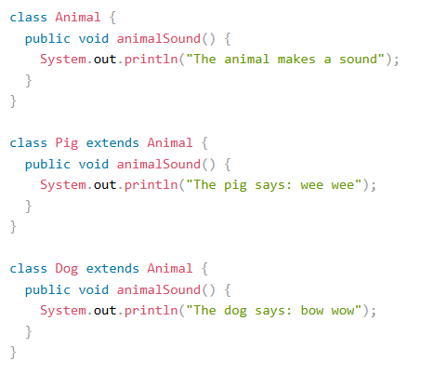
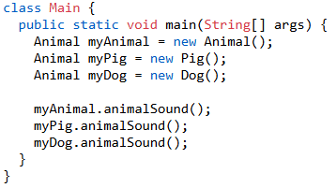
Eg.

Slide 4
Types of Polymorphism
Compile-time Polymorphism (Method Overloading): (Achieved by defining multiple methods in the same class with the same name but different signatures (different numbers or types of parameters)
Runtime Polymorphism (Method Overriding) (Achieved by defining a method in a subclass that has the same name and signature as a method in its superclass.)

Slide 5
Advantage of polymorphism
Reuasability
Extensibility
Simplified code

Slide 6
Question
Consider a scenario where Bank is a class that provides a method to get the rate of interest. However, the rate of interest may differ according to banks. For example, SBI, ICICI, and AXIS banks are providing 8.4%, 7.3%, and 9.7% rate of interest.

